Slide 1
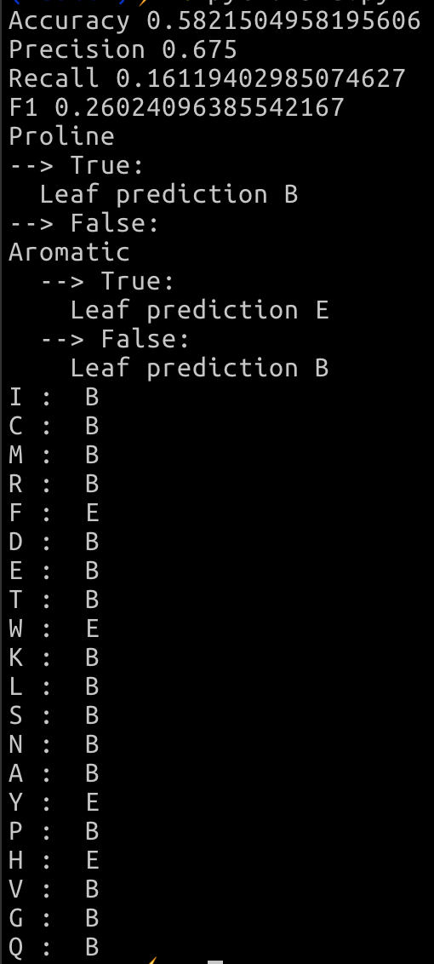
Project 2
Find best partition
Partition into True/False
Recurse build tree on True
Recurse build tree on false
Return node
Build tree
Winston Van
Dict of sets with attributes
“A”: {“Polar”}
Match returns self.trait in residues[record]
Sort training and test through random assignment
Build tree on training data
Find best partition
Iterate through attributes
Calculate information gain from shannon entropy
If no gain, save as leaf
Partition
Create Node with question
Accuracy, precision, recall, F1
Conclusion:
Building the decision tree by dividing the data with a question that yields the greatest information gain results in slight improvements over random coin flips.
Greedy ID3 decision tree will give accuracy measurements close to 55-58%.

